Slide 1
Django (and Web Application Frameworks)
Joel Bremson
May 16, 2011
jbremson@ucdavis.edu
@LUGOD

Slide 2
Web Application Frameworks

Slide 3
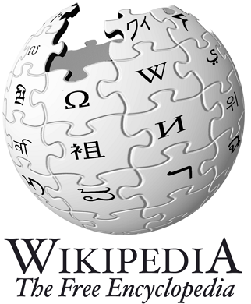
Definition
A web application framework is a software framework that is designed to support the development of dynamic websites, web applications and web services.
- http://en.wikipedia.org/wiki/Web_application_framework

Slide 4
Options!
???

Slide 5
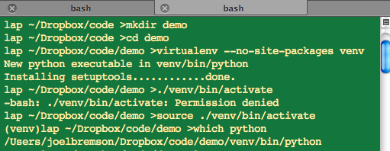
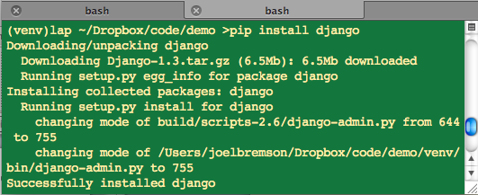
Installing Django

Slide 6
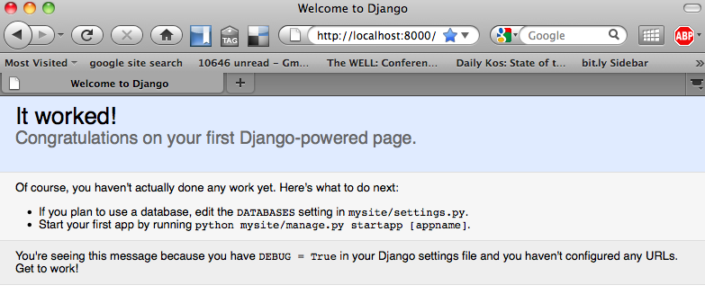
Installing Django

Slide 7
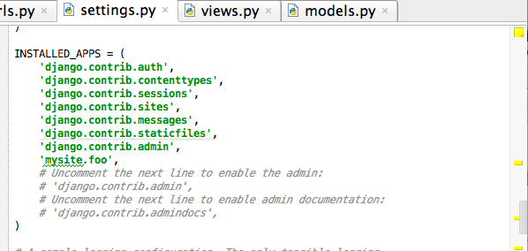
settings.py

Slide 8
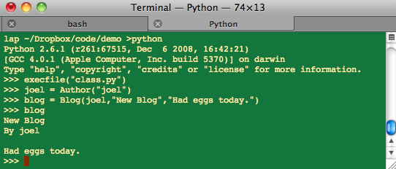
Django is Python

Slide 9
Python -> Django

Slide 10
The Tools
virtualenv
pip
fabric

Slide 11
Getting Help
www.djangoproject.com
stackoverflow.com
www.python.org
IRC - #django on freenode.net

Slide 12
Thanks
Questions
http://autopiagame.com
jbremson@ucdavis.edu

